Slide 1
HTML 5 - Training

Slide 2
What is HTML?
HTML (HyperText Markup Language) is the most basic building block of the Web.
HTML describes the structure of a Web page.
HTML consists of a series of elements.
HTML elements tell the browser how to display the content.
HTML elements are represented by tags.
HTML tags label pieces of content such as "heading", "paragraph", "table", and so on.
Browsers do not display the HTML tags, but use them to render the content of the page

Slide 3
What is Hypertext & Markup?
Hypertext is a text which references to other text.
Hypertext means machine readable text and Markup means to structure it in a specific format.
So, HTML is called hypertext markup language because it is a language that allows users to organize, improve the appearance of, and link text with data on the internet.

Slide 4
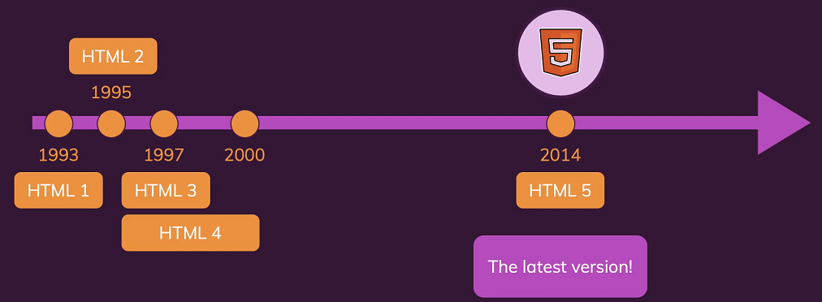
History of HTML

Slide 5
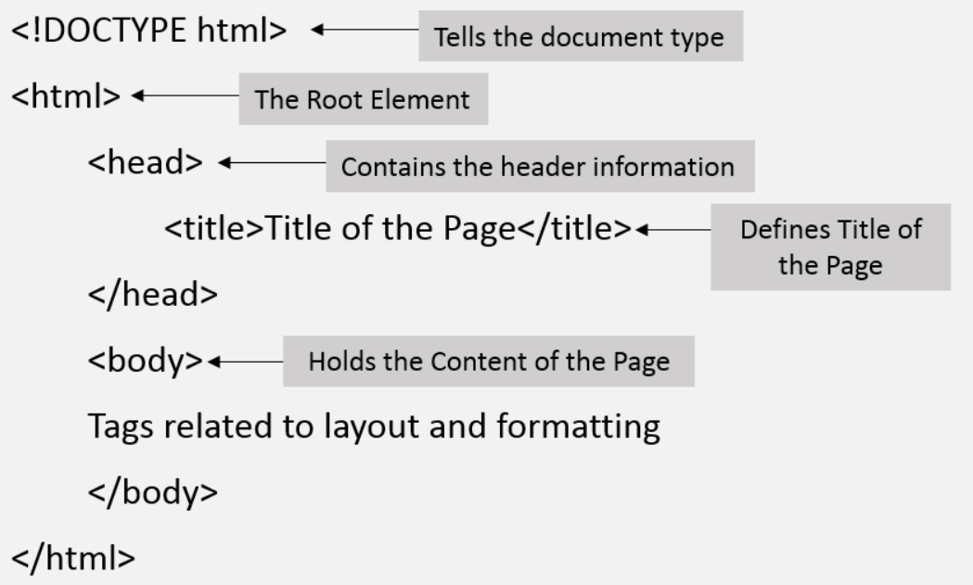
Structure of HTML

Slide 6
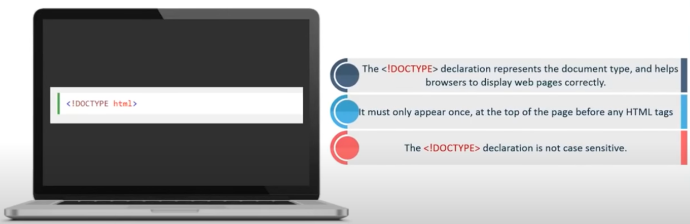
<!Doctype html> Declaration

Slide 7
HTML – Head Tag Containers
The Head Element
Title tag
Style tag
Link tag
Script tag
Meta tag

Slide 8
Structure of HTML continue..
The Head Element
The <head> element is a container for metadata and is placed between the <html> tag and the <body> tag.
HTML metadata is data about the HTML document.
Metadata typically define the document title, character set, styles, scripts, and other meta information.
The <title> Element
The <title> element defines the title of the document.
Defines a title in the browser toolbar
Provides a title for the page when it is added to favorites
Displays a title for the page in search engine-results

Slide 9
HTML Body Tags
Heading Tags - <h1>, <h2>, <h3>, <h4>, <h5>, <h6> tags.
Paragraph Tag - <p> tag.
Horizontal ruler - <hr> tag.
Anchor(Link) Tag - <a> (anchor) tag.
List Tag - <ul> (unordered list), <ol> (ordered list) and <li> (list element) tags.
Image Tag - <img> tag
Divider, denoted using the <div> tag
Text span, denoted using the <span> tag

Slide 10
HTML Elements
HTML Headings
HTML headings are defined with the <h1> to <h6> tags.
<h1> defines the most important heading. <h6> defines the least important heading.
HTML Paragraphs
HTML paragraphs are defined with the <p> tag.
<h1>This is heading 1</h1> <h2>This is heading 2</h2> <h3>This is heading 3</h3>
15hrs
<p>This is a paragraph.</p>
<p>This is another paragraph.</p>

Slide 11
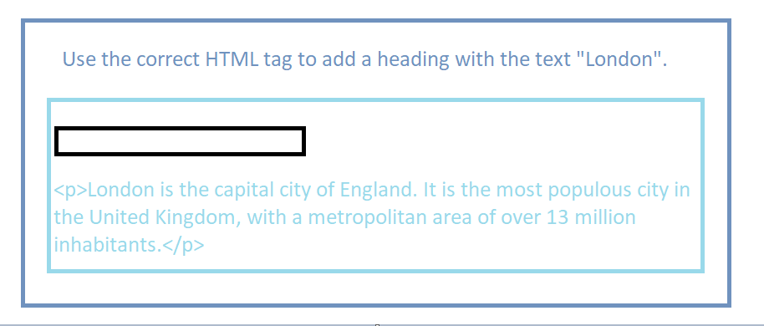
QUESTION

Slide 12
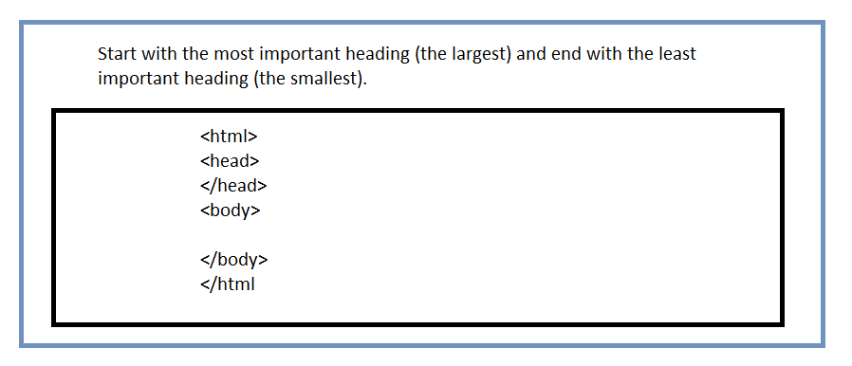
QUESTION

Slide 13
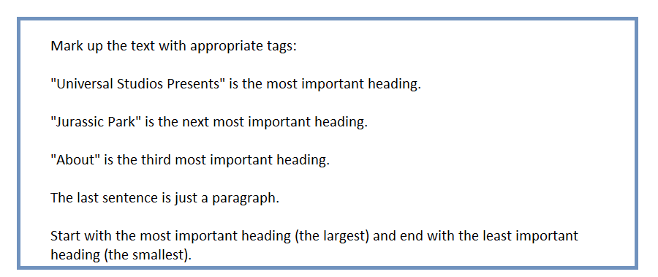
QUESTION

Slide 14
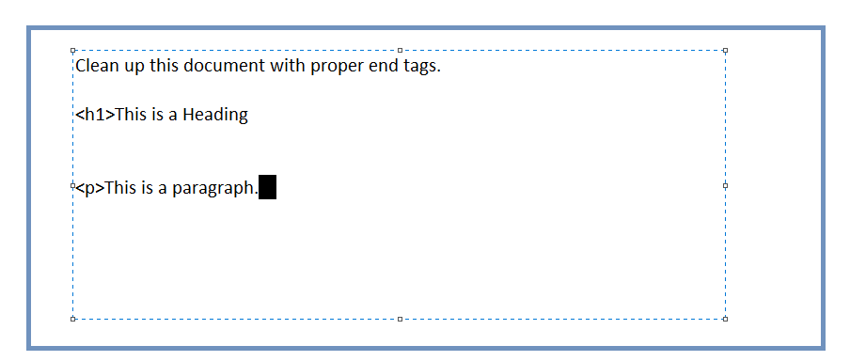
QUESTION

Slide 15
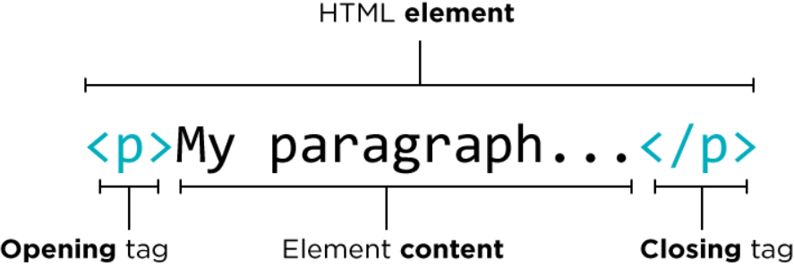
HTML Element, Tag

Slide 16
Main Categories of Elements and Attributes
The main categories of elements are mentioned below:
Block level elements :
<div>, <p>, <h1> to <h6>, <form>, <table> etc.,
Inline elements :
<img>, <a>, <span>, <input> etc.,
Attributes:
Attributes are something which give the additional information of the element.
Ex. name, width, height, alt, title, href, id, class, etc.,

Slide 17
HTML Block and Inline Elements
Every HTML element has a default display value, depending on what type of element it is.
There are two display values: block and inline.
Block-level Elements:
A block-level element always begins a new line on a web page.
It extends the full width of the available horizontal space of its parent element.
A block level element has a top and a bottom margin, whereas an inline element does not.
Eg: <div></div>

Slide 18
HTML Block and Inline Elements continue..
Inline Elements
An inline element does not start on a new line.
An inline element only takes up as much width as necessary.
Eg: <span></span>
Note: An inline element cannot contain a block-level element!

Slide 19
HTML Elements continue..
HTML <div> Tag
The <div> tag defines a division or a section in an HTML document.
The <div> element is often used as a container for other HTML elements
HTML <span> Tag
The <span> tag is used to group inline-elements in a document.
The <span> tag provides no visual change by itself.
The <span> tag provides a way to add a hook to a part of a text or a part of a document
<div style="background-color:lightblue"> <h3>This is a heading</h3> <p>This is a paragraph.</p> </div>
<p>My mother has <span style="color:blue">blue</span> eyes.</p>

Slide 20
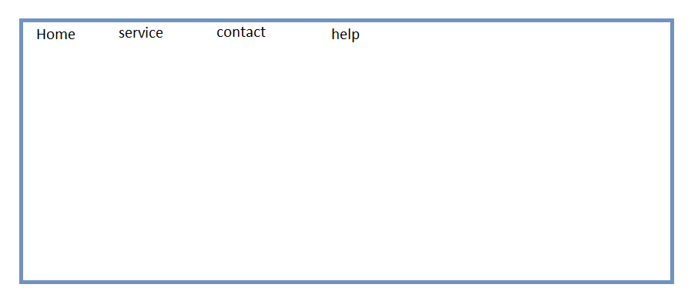
QUESTION

Slide 21
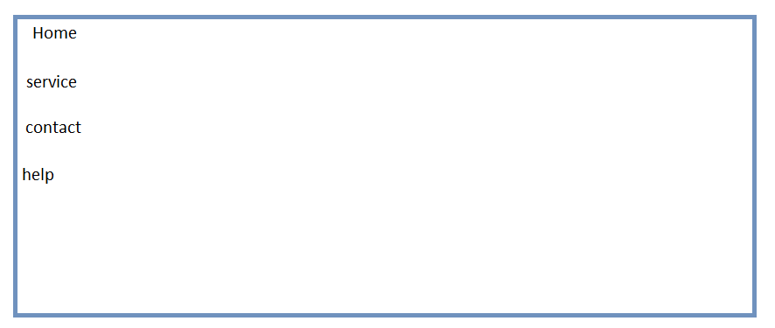
QUESTION

Slide 22
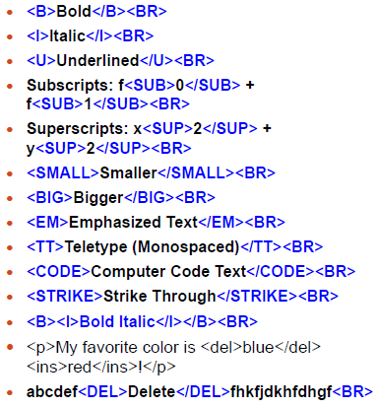
formatting TAGS

Slide 23
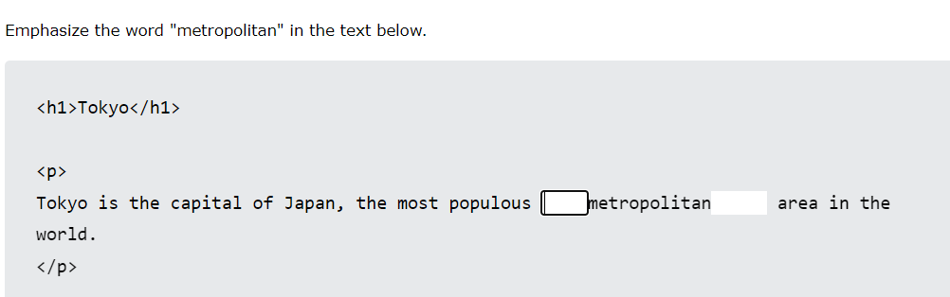
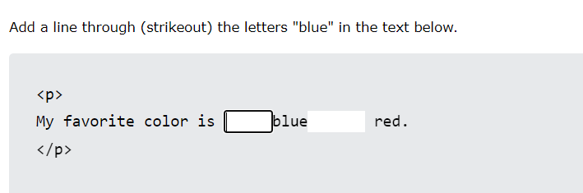

Slide 24
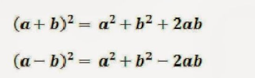

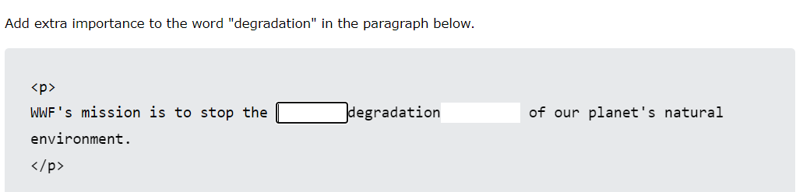
QUESTION

Slide 25
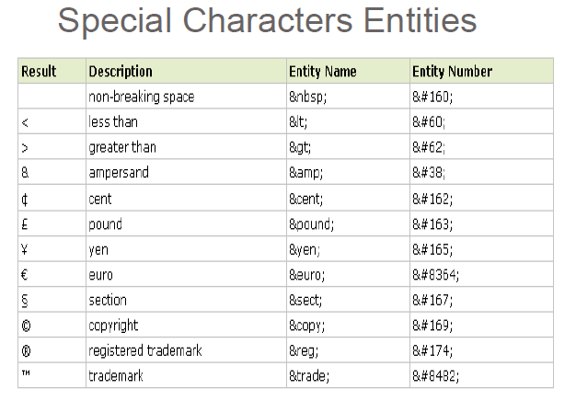

Slide 26

QUESTION

Slide 27
Empty HTML Elements
HTML elements with no content are called empty elements.
Line Break Tag
<br> is an empty element without a closing tag (the <br> tag defines a line break).
<p>This is a <br /> paragraph with a line break.</p>
Horizontal Lines
Horizontal lines are used to visually break-up sections of a document.
<p>This is paragraph one and should be on top</p>
<hr />
<p>This is paragraph two and should be at bottom</p>

Slide 28
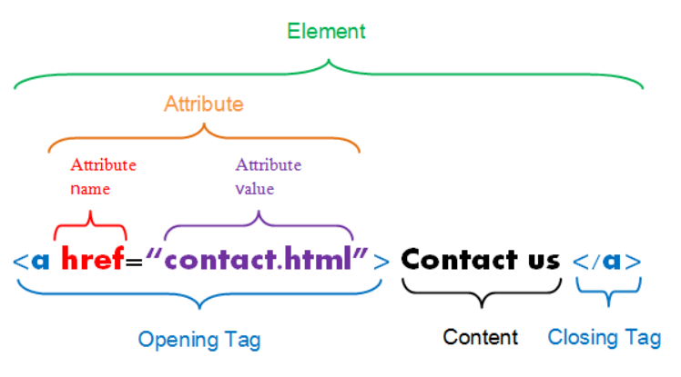
HTML ATTRIBUTE

Slide 29

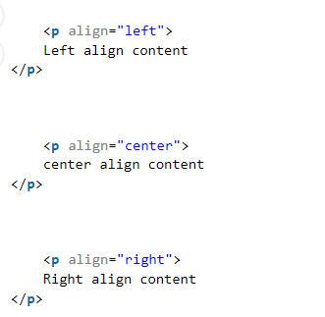



Types of attributes

Slide 30
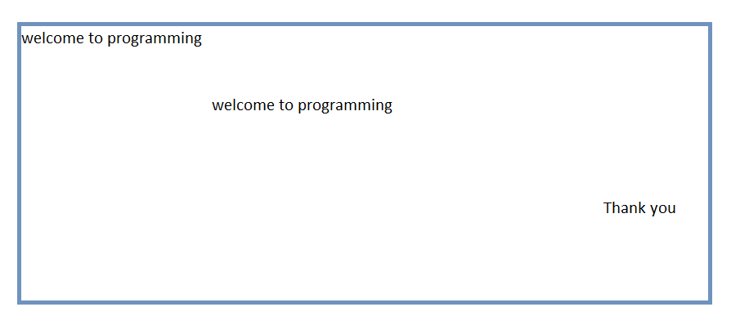
QUESTION – Attribute?

Slide 31
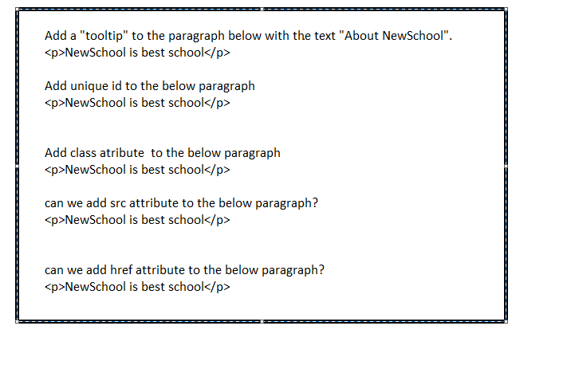
QUESTION HTML ATTRIBUTE

Slide 32
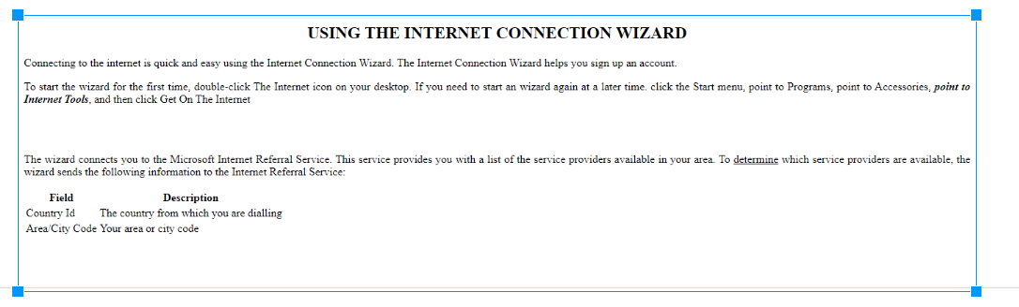
ASSIGNMENT

Slide 33
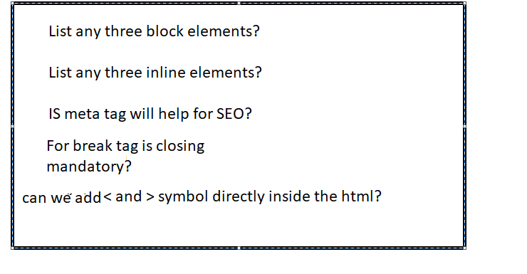
QUESTION?

